Slide 1
Quantum Computing
Davetivo Weaver

Slide 2
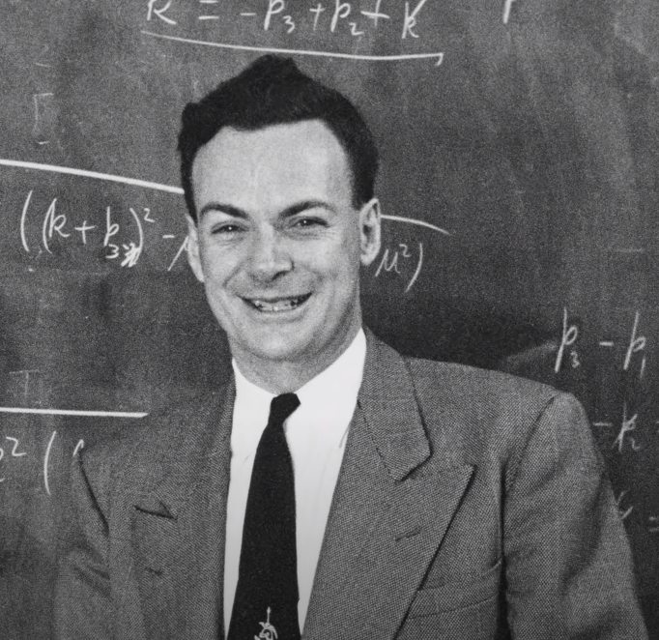
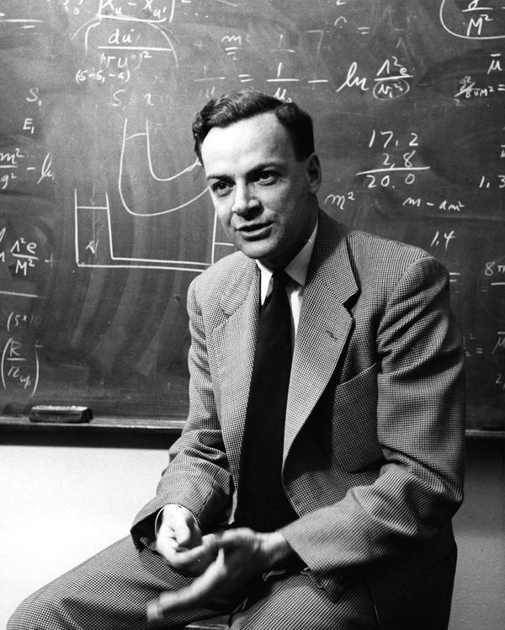
Richard Feynman (1918 - 1988)

Slide 3
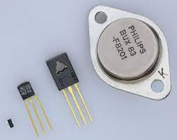
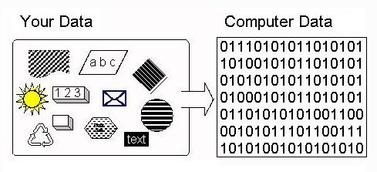
The problem with modern computers
Transistor Binary

Slide 4
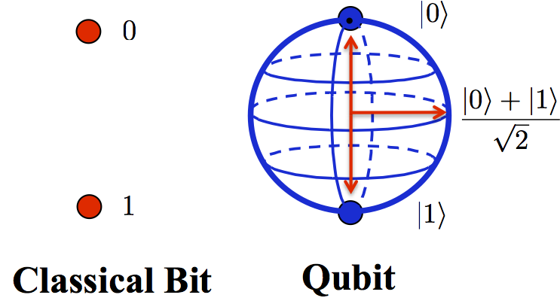
Qbits

Slide 5

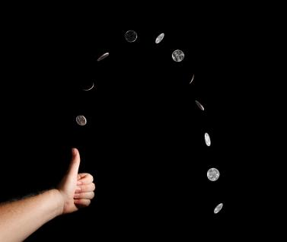
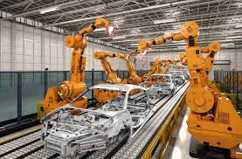
Society and Quantum Computing

Slide 6
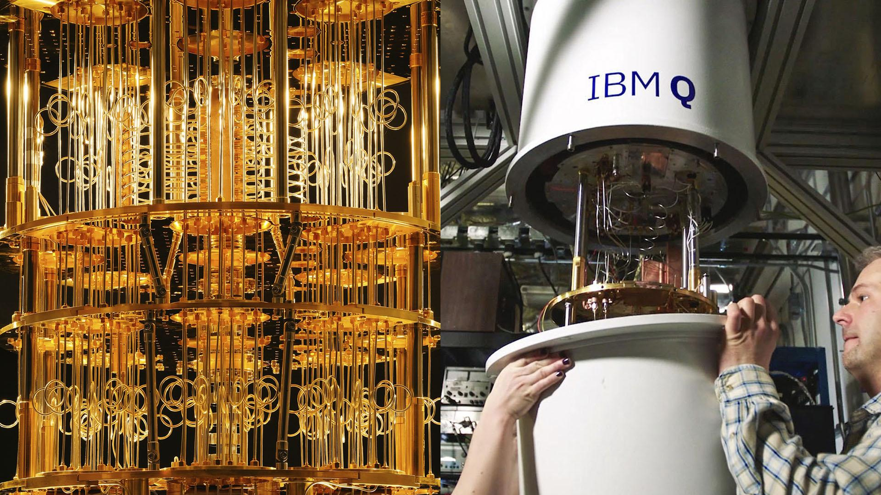
The End

Slide 7
References
https://www.youtube.com/watch?v=JhHMJCUmq28
https://www.youtube.com/watch?v=jHoEjvuPoB8&t=120s
https://www.youtube.com/watch?v=X8MZWCGgIb8&t=1s
https://www.youtube.com/watch?v=SORSZ9Je-8g
https://www.youtube.com/watch?v=jHoEjvuPoB8&t=120s

